Slide 1
Machine Learning Methods for ASD Classification and Prediction
Kimberly Glock
MSDS 5213

Slide 2
What is ASD?
autism spectrum disorder (ASD)
broad range of symptoms such as challenges with social skills, repetitive behaviors, speech and nonverbal communication
many subtypes of autism, most influenced by a combination of genetic and environmental factors
some people with ASD require significant support in their daily lives, while others may need less support and, in some cases, live entirely independently
no cure but research shows that early intervention leads to positive outcomes later in life for people with autism
Source: autismspeaks.org

Slide 3
Dataset
https://archive.ics.uci.edu/ml/datasets/Autism+Screening+Adult
title: Autistic Spectrum Disorder Screening Data for Adult
source: Machine Learning Repository of the University of California, Irvine
acknowledgement of original dataset author: Fadi Fayez Thabtah, Department of Digital Technology, Manukau Institute of Technology, Auckland, New Zealand

Slide 4
Dataset
survey app created by the author of the dataset: http://asdtests.com/?fbclid=IwAR3oKglSCk4cK3Yrxth-4rlqPN2z4vUUdgeyTBAfRf_V7G-yZenndAbYGXg
10 behavioral questions, A1 - A10
10 demographic questions such as ethnicity and age
behavioral questions: agree or disagree format (binary: 0 and 1) and identify autistic traits
survey is not diagnostic but an aid to help clinicians with diagnosis
example question: A9 - I find it easy to work out what someone is thinking or feeling just by looking at their face.
This question proved to be the most significant predictor variable in my models followed by A6, A5, and A4. All four of these questions are social que questions where autistic individuals have challenges.
Notes:
It makes practical sense that those 4 variables are the most important predictor variables of ASD or not.

Slide 5
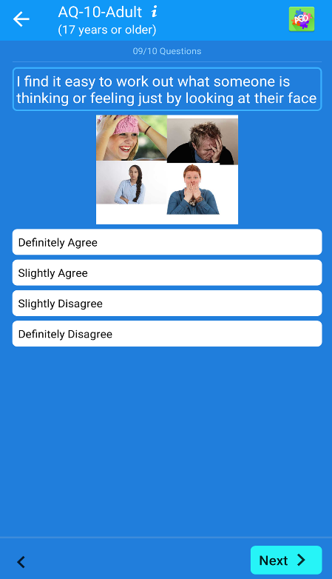
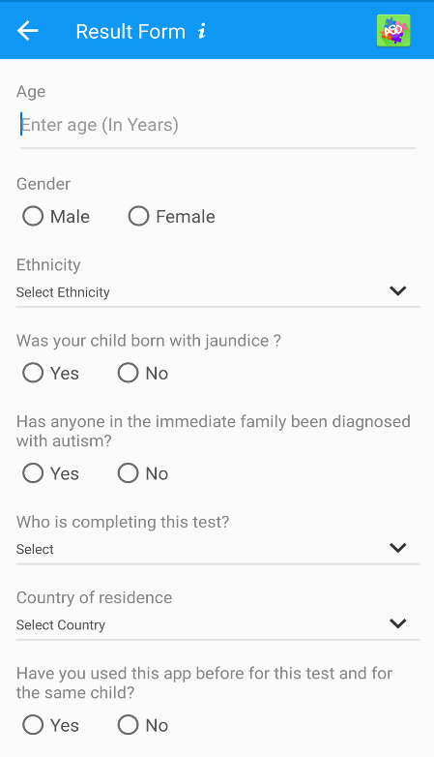
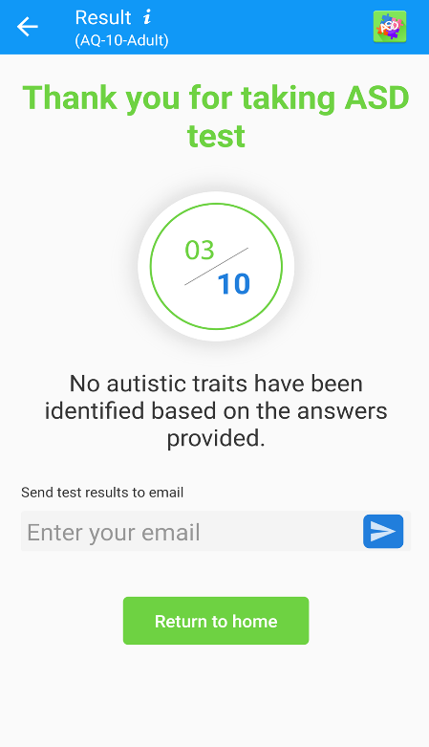
Survey App
Notes:
*I TOOK SURVEY.
*FIRST PIC IS EXAMPLE OF QUESTION A9 WHICH IS THE STATISTICALLY MOST SIGNIFICANT PREDICTOR VARIABLE
*SECOND PIC ARE THE DEMOGRAPHIC QUESTIONS, PART OF THE DATASET

Slide 6
Dataset Description
21 columns and 704 instances
two continuous numeric variables: “age” and “result”, nine categorical variables: “gender”, “ethnicity”, “jaundice”, “autism”, “country_of_res”, “used_app_before”, “age_desc”, “relation”, and “Class_ASD” and ten binary variables: ”A1_Score” – “A10_Score”
target /dependent/output variable: “Class_ASD”: no or yes

Slide 7
Data Science Question
Can machine learning and an app administered survey aid clinicians in obtaining a more rapid diagnosis of ASD and furthermore save in healthcare costs and improve quality of life in ASD persons?
survey is time-efficient and easily accessible
potentially save money in healthcare costs
reduce wait times for a diagnosis
survey suggests to individuals whether they should pursue formal clinical diagnosis
early diagnosis and intervention improves the quality of life for ASD individuals

Slide 8
Imputation
changed three mispelled column names: “jundice”, “austim”, “contry_of_res”
changed the name of “Class/ASD” to “Class_ASD” to avoid problems with the slash
combined two "others” catagories“ under the “ethnicity” column
replaced an age value of 383 with 38 (outlier/typo?) in “age” column
replaced two missing values in the “age” column with the mean
replaced ninety-five missing values each in the “ethnicity” and the “relation” columns with “unknown”
dropped three columns: “country_of_res” (too many factors with 67), “result” column is related to Class_ASD and could give models the outcome of the target variable and “age_desc” as it only had one level plus we have an age column
one hot encoded aka created dummy variables (0 is negative and 1 is positive) to make all predictor variables numerical except for the target variable
Notes:
*I IMPUTED DIFFERENT WAYS AND RAN SOME MODELS: DROPPED NA ROWS, COMBINED NAS WITH THE OTHERS CATEGORY, AND LASTLY LABELED ALL NAS AS UNKNOWN. ACCURACY WAS SIMILAR BETWEEN ALL. I WENT WITH THE LABELING UNKNOWN OPTION AS IT FELT MORE OBJECTIVE AND AFTER CONSULTING WITH DR CAO.
LOTS OF WORK!!

Slide 9
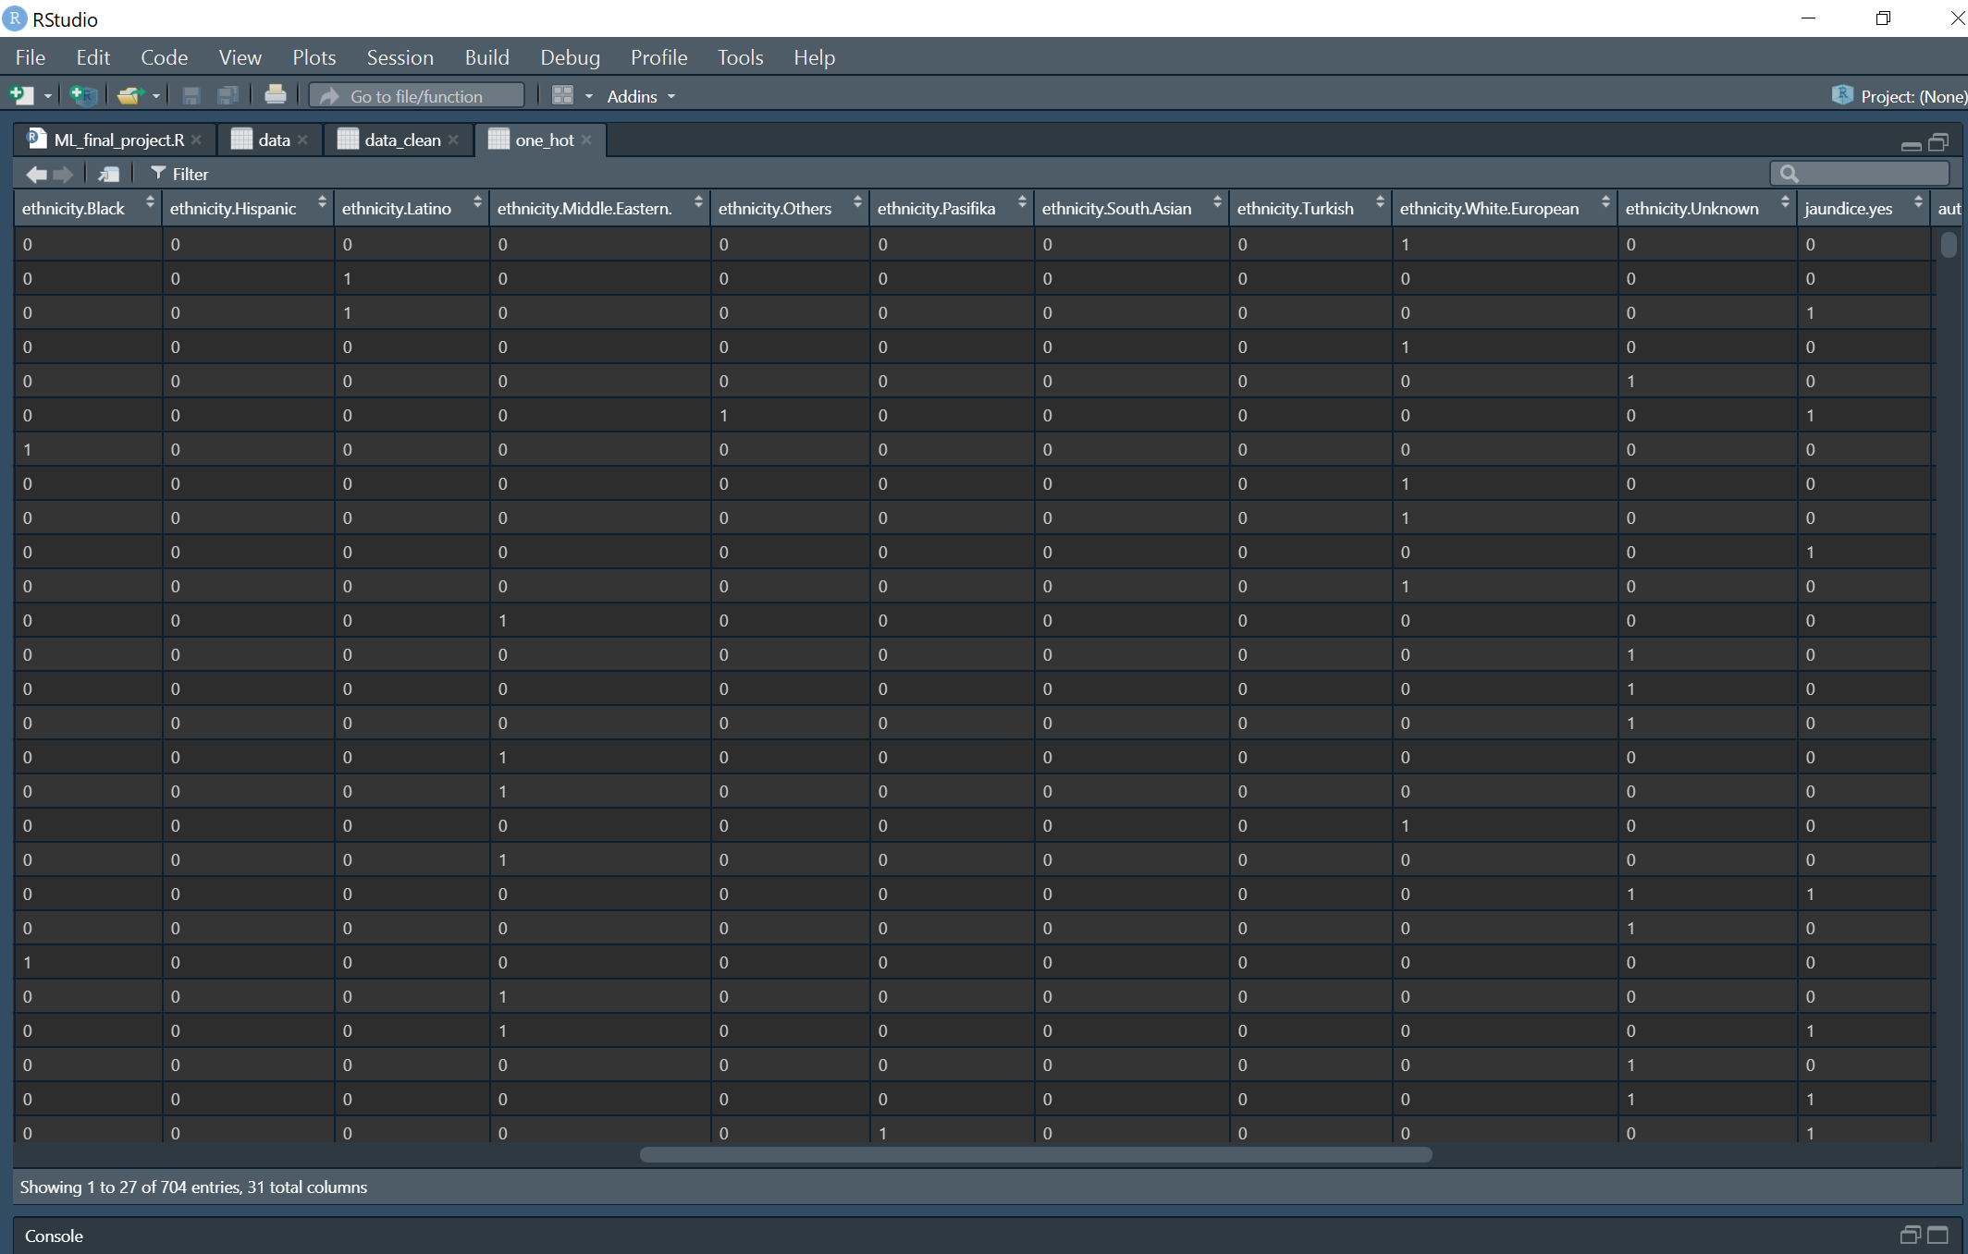
18 columns and 704 instances
Notes:
***CLEANED DATA: LEFT WITH 18 COLUMNS (MINUS 3 COLUMNS) AND 704 INSTANCES (SAME)

Slide 10
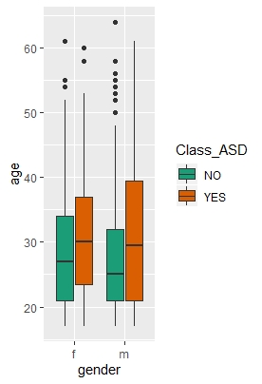
Age, Gender and ASD Class
Notes:
*1st plot: female on left and male on right. Green color represents individuals that did not score for ASD traits and the orange color represents individuals that did score yes for autistic traits. See the age distribution on the x axis using the boxplots.
*2nd plot: is another similar view that shows the age distribution, mean age and Class_ASD

Slide 11
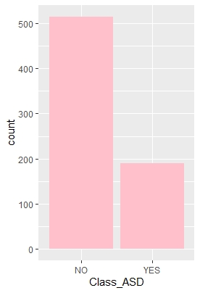
ASD Class Count
Notes:
***DATASET IS HEAVILY BIASED WITH OVER 500 NO FOR CLASS_ASD AND A LITTLE UNDER 200 FOR YES CLASS_ASD

Slide 12
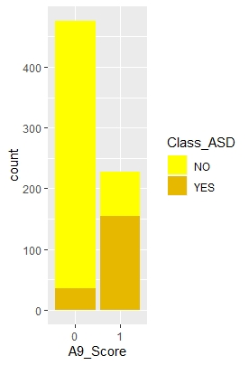
ASD Class and A9_Score
Notes:
***THE MOST SIGNIFICANT PREDICTOR VARIABLE A9_SCORE. YOU CAN SEE THAT AGREEING WITH THAT QUESTION GIVES A 1 AND MORE THAN LIKELY INDICATES AN AUTISTIC TRAIT

Slide 13
Notes:
***DATASET IS HEAVILY BIASED WITH MOSTLY WHITE-EUROPEAN FOLLOWED BY ASIAN AND OTHERS

Slide 14
Model Results: Pre-Lasso Selection
RESULTS | KNN | DECISION TREE | RANDOM FOREST | SVM Poly Kernal
Accuracy | 0.967 | 0.929 | 0.9575 | 1
P-Value | 1.658e-15 | 1.108e-09 | 8.575e-14 | 2e-16
Kappa | 0.905 | 0.783 | 0.872 | 1
Sensitivity | 0.9817 | 0.9817 | 0.9939 | 1
Specificity | 0.9167 | 0.7500 | 0.8333 | 1
AUC | 0.9952 | 0.9662 | 0.9912 | 0.9992
Best Parameters | k=3 | cp=0.005 | mtry=4 32 trees | Degree=1 Scale=10 C=0.25
Notes:
*DATA SPLIT INTO 70/30 FOR TRAINING TESTING
*BEST RESULTS HIGHLIGHTED IN YELLOW…..MY DATA SEPARATES EXTREMELY WELL!!

Slide 15
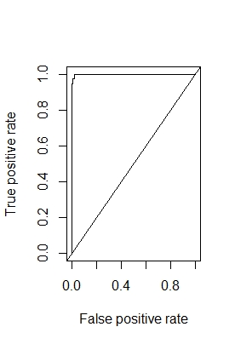
SVM Polynomial
Degree = 1, scale = 10 and cost = 0.25 (blue)
Notes:
***BEST PARAMETERS: DEGREE 1 (BOTTOM LEFT), SCALE 10 (X AXIS), AND COST 0.25 (BLUE LINE)
***AUC CURVE

Slide 16
Important Variables (RF)
Notes:
***THE MOST IMPORTANT RANDOM FOREST PREDICTOR VARIABLES: A9_SCORE FOLLOWED BY A6, A5, AND A4. ALL SOCIAL CUE QUESTIONS!!! ASD INDIVIDUALS HAVE CHALLENGES WITH SOCIAL CUES.

Slide 17
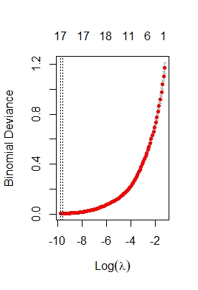
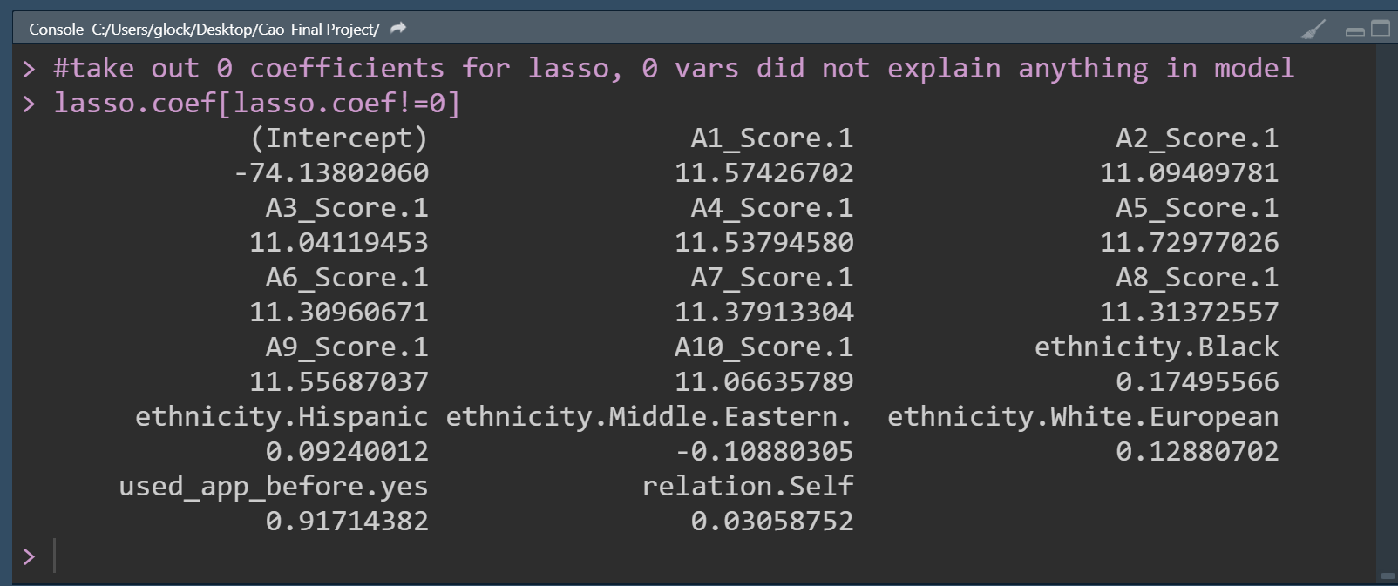
Lasso Selected Variables
Best lambda = 5.154182e-05
16 columns and 704 instances
Notes:
***BEST LAMBDA IS 5.154182e-05 or 5 to the negative 05
***MOST OF THE SELECTED VARIABLES ARE THE SURVEY QUESTIONS
****AFTER LASSO VARIABLE SELECTION LEFT WITH 16 COLUMNS AND 704 INSTANCES

Slide 18
Model Results: Pre-Lasso Selection
RESULTS | LOGISTIC REGRESSION | RANDOM FOREST | NEURAL NETWORK
Accuracy | 1 | 0.9764 | 1
P-Value | 2.2e-16 | <2e-16 | <2e-16
Kappa | 1 | 0.933 | 1
Sensitivity | 1 | 0.9938 | 1
Specificity | 1 | 0.9200 | 1
AUC | 0.9992 | 0.9961 | 1
Best Parameters | A1-A10 are significant | mtry=3 17 trees | hidden units=5 decay=1e-04
Notes:
*FOR REGRESSION I HAD TO USE BAYESGLM DUE TO TWO ERRORS: algorithm did not converge and fitted probabilities numerically 0 or 1 occurred. This regularized the coefficients and took care of the errors.
*LOGISTIC REGRESSION SELECT ALL SURVERY SCORES A1-A10 AS SIGNIFICANT
*BEST RESULTS HIGHLIGHTED IN YELLOW…..MY DATA SEPARATES EXTREMELY WELL OR IS OVERFITTING!!
*NEURAL NETWORK IS BEST

Slide 19
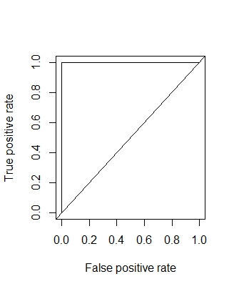
Neural Network Model
units = 5 and decay/lr = 1e-04 (pink)
Notes:
***BEST PARAMETERS: 5 HIDDEN UNITS AND DECAY 1e-04 (PINK LINE)////ACCURACY HITS ONE AND STAYS
***AUC CURVE OF 1, A RIGHT ANGLE!!!

Slide 20
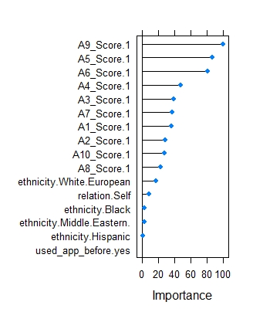
Important Variables (RF/Lasso)
Notes:
***THE MOST IMPORTANT RANDOM FOREST LASSO PREDICTOR VARIABLES: A9_SCORE FOLLOWED BY A6, A5, AND A4. ALL SOCIAL CUE QUESTIONS!!! ASD INDIVIDUALS HAVE CHALLENGES WITH SOCIAL CUES.

Slide 21
Comments
SVM polynomial and the lasso neural net were the best models with perfect accuracy and the neural net had an AUC of 1 (100% accuracy is not common but possible)
possibly because of linearly separable data? no overlapping points?
overfitting somehow: memorizing the training set?, one column has the exact same values as the target?=no, or test and training data too much alike?
could the data be processed better?
need more data, more features?
There is a model created in Python using this dataset. They also got a 1 for accuracy using a logistic regression model.
https://www.kaggle.com/miodeq/asd-prediction-with-logistic-regression

Slide 22
Recommendations and Conclusions
This dataset is highly biased towards the ASD class of no and the ethnicity of white European. I recommended collecting a more balanced dataset in the future for more accurate and unbiased modeling.
The high accuracy scores need to be further researched to determine if the data is truly highly separable or if something else in the data needs to be addressed and the models retrained.
I conclude that the survey scores are statistically reliable predictors of the target variable.
I hypothesize that with further data collection and ML, the survey could indeed be an important aid to clinicians in diagnosing ASD and reducing healthcare costs. ML methods have proven this survey dataset to be useful in predicting the outcomes of the target.

Slide 23

EL FIN! Thank you! Any questions, comments or suggestions?

